Slide 1


Session 6. T24 Menus
Transact (T24) Technical Induction Training
Minsk, 2021

Slide 2




Agenda
Menus in T24
Menu Types
Creation of Menus
Menus and user profiles
Role based Home Pages
Workshops

Slide 3

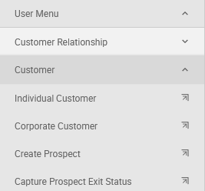

Menus in T24
What?
A group of applications and enquiries that the user can choose from without the need to remember application names or commands
Why?
For Easy navigation
It will be easier for end users if they did not have to remember all application names or commands
As soon as a user logs in to T24, if all options needed to access required data is readily available on a menu
Role–based pages make implementation easy for the bank
Control access of different users without setting security at the user profile level
Notes:
Novice users don’t need to remember application names and can easily navigate using menus to accomplish their tasks.
T24 allows you to create menus according to each users work profile
Related tasks can be grouped together using the menus and submenus.

Slide 4
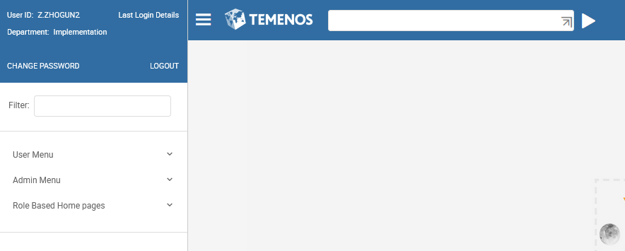
Menus in T24
Click to open side bar with menu
Notes:
The illustration shows how a typical menu appears in T24.
The highest level in this menu structure has three submenus namely User Menu, Admin Menu and Role Based Home Pages. The menus can be expanded by clicking on the menu.
All user related tasks are grouped under the user menu and administration tasks are grouped under admin menu. This helps the user to navigate easily.
When the user expands a menu item by clicking on the menu, the submenus are listed for each of the top level menus.
User Menu, Admin Menu and Role Based Home Pages form the first level of menus.
Customer, CRM, Contact Management, Product Catalog, Retail Operations, Credit Operations and others form the second level.
Under Credit operations, Limits, Collateral and Loans form the third level.
In Limits, Limit Menu, Group Limits , Enquiries and ‘View COB Reports’ form the fourth level.
In this illustration, some T24 applications are listed under Group limits. These are also referred as menu items.

Slide 5
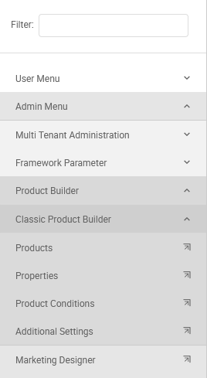
Menus in T24
Level 1
Level 2
Level 3
Level 4
Level 3
Notes:
The illustration shows how a typical menu appears in T24.
The highest level in this menu structure has three submenus namely User Menu, Admin Menu and Role Based Home Pages. The menus can be expanded by clicking on the menu.
All user related tasks are grouped under the user menu and administration tasks are grouped under admin menu. This helps the user to navigate easily.
When the user expands a menu item by clicking on the menu, the submenus are listed for each of the top level menus.
User Menu, Admin Menu and Role Based Home Pages form the first level of menus.
Customer, CRM, Contact Management, Product Catalog, Retail Operations, Credit Operations and others form the second level.
Under Credit operations, Limits, Collateral and Loans form the third level.
In Limits, Limit Menu, Group Limits , Enquiries and ‘View COB Reports’ form the fourth level.
In this illustration, some T24 applications are listed under Group limits. These are also referred as menu items.

Slide 6
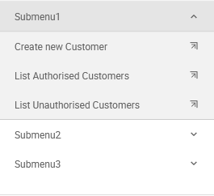
Task - Creation of Menus
Sub-menus are created using HELPTEXT.MENU application
Higher level grouping of sub-menus is done using HELPTEXT.MAINMENU application
Notes:
Lets understand how to create these submenus and parent menus.
Sub menus are created using HELPTEXT.MENU application in T24
Parent menus are created using HELPTEXT.MAINMENU application and is used to combine the submenus into a main entity.
To learn to create menus in T24, this learning unit demonstrates how you would create a simple menu like the one in the illustration.
The menu that you can see above is one main menu, which has three smaller menus attached as indicated by the arrows. Each of the these submenus have numerous menu items. You have already seen that there are two different applications in T24 that you will use to create menus. You will now learn how to use them.

Slide 7
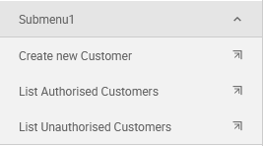
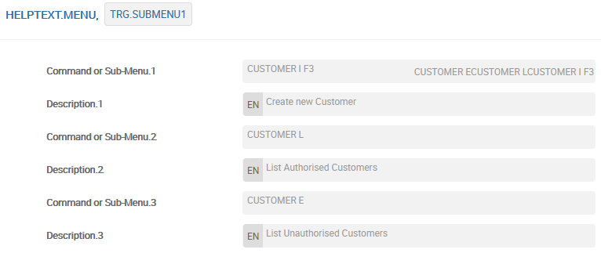
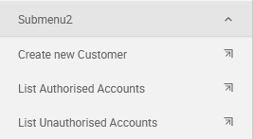
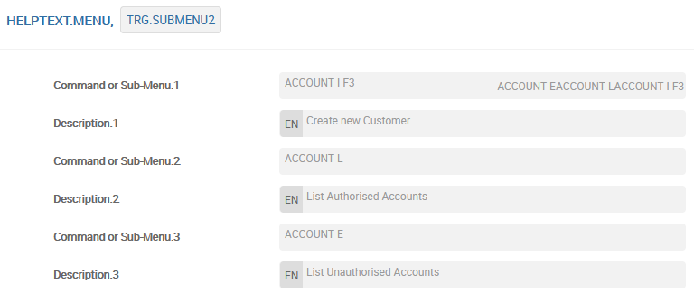
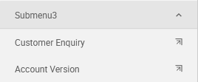
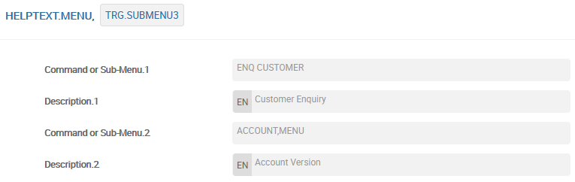
Create The Sub Menus Using HELPTEXT.MENU
Notes:
To create the required menu, you will need 3 records in HELPTEXT.MENU.
1. Submenu1 has three menu items to create a customer record, list authorized and unauthorized customer records.
2. The record TRG.SUBMENU1 is created for this purpose.
3. Submenu2 has three menu items to create an account and list unauthorised and authorised accounts.
The record TRG.SUBMENU2 is created for this purpose
Submenu3 has two menu items to launch an account version and an enquiry to list the customer details.
6. The record TRG.SUBMENU3 is created for this purpose

Slide 8
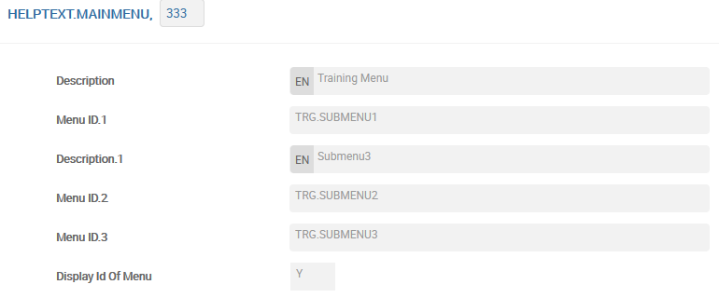

Create The Main Menu Using HELPTEXT.MAINMENU
You can invoke menus from Command Line too
Notes:
Now that the 3 submenus are ready, how can you use them? All submenus must be attached to create a main menu. This is done using the HELPTEXT.MAINMENU application.
ID : Has to be numeric
GB Title : Description for the main menu
Id Of Help Menu : The whole idea of using this application is to bring together existing submenus. This field must hold an the ID of an existing HELPTEXT.MENU
GB Description.3 : Description that will appear for the group of submenus
This is the record that must be created in order to group the three sub menus
The ID of the HELPTEXT.MAINMENU in this example is 333
The submenus TRG.SUBMENU1, TRG.SUBMENU2 and TRG.SUBMENU1 are attached to this record
Do not forget to commit and authorize the record.

Slide 9
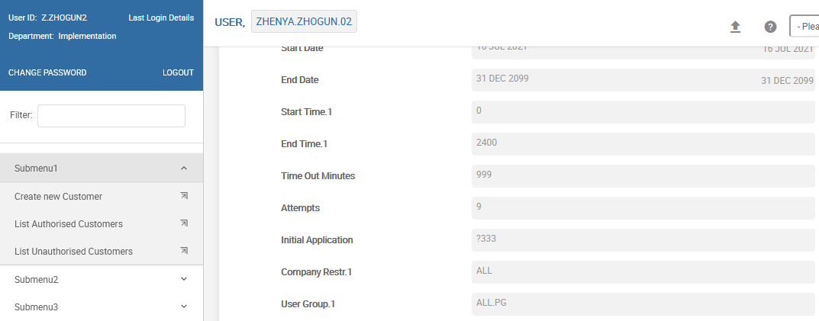
Attaching the menu to the user profile
You can attach menus to a user profile too
Notes:
To attach a menu to a user profile, specify the ID of the HELPTEXT.MAINMENU created in the Init.Application field of the USER profile. The menu id must be prefixed with a ?

Slide 10
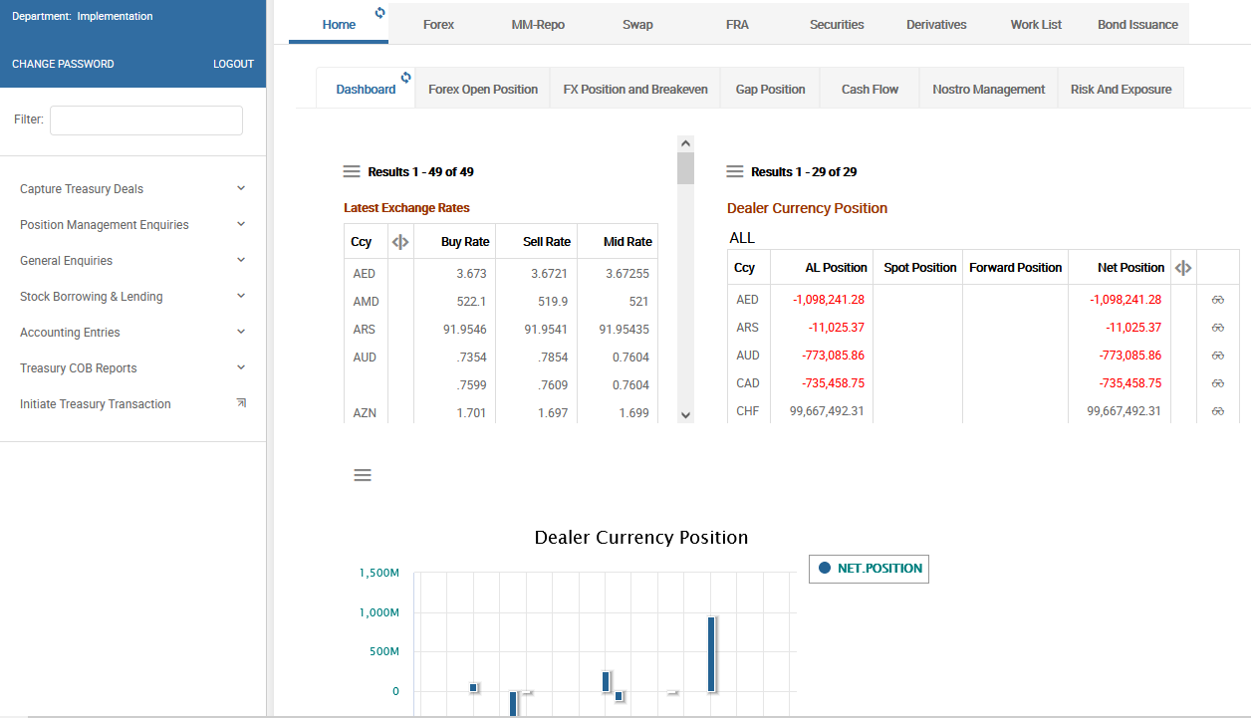
Role based Home Pages – Treasury Front-Office
Notes:
COS TREASURY.MAIN.HP

Slide 11
Workshop - 1
Create your own Main Menu that includes 2 Sub Menus:
1-st Sub Menu consists of points
‘Create new Abbreviation’ (based on application ABBREVIATION, with function of inputting new record);
‘List Authorised Abbreviations’ (based on list of authorised records in application ABBREVIATION)
2-nd Sub Menu consists of points
‘Create new Currency’ (based on application CURRENCY, with function of inputting new record);
‘List Unauthorised Currencies’ (based on list of unauthorized records in application CURRENCY)
Invoke your created Main Menu from Command Line
Attach your created Main Menu to your User profile and authorize it
Log in to the system with this User and check if your created Main Menu is invoked

Slide 12
Thank you for your time and attention!
FORANX LLC
Legal address:
35A, Ponomarenko str., 201 office, Minsk, 220015, Belarus
Tel.:+ 375 17 202 76 78
+ 375 17 202 76 79
Fax: + 375 17 362 34 22
Web-site: www.foranx.by
Minsk, 2021

